Slide 1
Frontend / Admin Dashboard

Slide 2


 |  | Home | CCTV | Statistics | Report | Event Log |  | Dashboard | User Settings | Log Out
7
📁Project
📁River Basin
📁Station
📁Sensor | >
📁Services | >
📁Team
📁User
<
Project (15)
▼
Status
Add
# | Project Name | Customer Name | Remark | status | Action
1 | โครงการส่งน้ำ |  |  |  | Edit
2 | มหาสารคาม |  |  |  | Edit
3 | สำนัก 6 |  |  |  | Edit
4 | การไฟฟ้า |  |  |  | Edit
5 | การประปา |  |  |  | Edit
6 | ทดสอบ |  |  |  | Edit
7 | ลำปลายมาศ |  |  |  | Edit
8 |  |  |  |  | Edit

Slide 3
 |  | Home | CCTV | Statistics | Report | Event Log |  | Dashboard | User Settings | Log Out
7
📁Project
📁River Basin
📁Station
📁Sensor | >
📁Services | >
📁Team
📁User
<
Project - Edit
Status
Project Name
Customer Name
Order
Remark
Save
Cancel
Delete

Slide 4
 |  | Home | CCTV | Statistics | Report | Event Log |  | Dashboard | User Settings | Log Out
7
📁Project
📁River Basin
📁Station
📁Sensor | >
📁Services | >
📁Team
📁User
<
River Basin (30)
▼
Status
Add
# | River Basin Name | Remark | Action
1 | จันทบุรี |  | Edit
2 | โขง |  | Edit
3 | ปัตตานี |  | Edit
4 | บางปะกง |  | Edit
5 | ห้วยหลวง |  | Edit
6 | ตาปี |  | Edit
7 | ชีใหม่ |  | Edit
8 |  |  | Edit

Slide 5
 |  | Home | CCTV | Statistics | Report | Event Log |  | Dashboard | User Settings | Log Out
7
📁Project
📁River Basin
📁Station
📁Sensor | >
📁Services | >
📁Team
📁User
<
River Basin - Edit
Status
River Basin Name
Order
Remark
Save
Cancel
Delete

Slide 6
 |  | Home | CCTV | Statistics | Report | Event Log |  | Dashboard | User Settings | Log Out
7
📁Project
📁River Basin
📁Station
📁Sensor | >
📁Services | >
📁Team
📁User
<
Station (15)
▼
▼
▼
River Basin Name
Status
Project name
Add
# | Project Name | River Basin Name | Site Name | Site Code | Remark | Action
1 | โครงการส่งน้ำ |  | โครงการส่งน้ำ | TC.01 |  | Edit
2 | มหาสารคาม |  | มหาสารคาม | TC.02 |  | Edit
3 | สำนัก 6 | ชายฝั่งทะเลตะวันออก | สำนัก 6 | TC.03 |  | Edit
4 | การไฟฟ้า |  | การไฟฟ้า | TC.04 |  | Edit
5 | การประปา |  | การประปา | TC.05 |  | Edit
6 | ทดสอบ |  | ทดสอบ | TC.06 |  | Edit
7 | ลำปลายมาศ |  | ลำปลายมาศ | TC.07 |  | Edit
8 |  |  |  | TC.08 |  | Edit

Slide 7
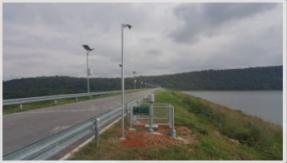
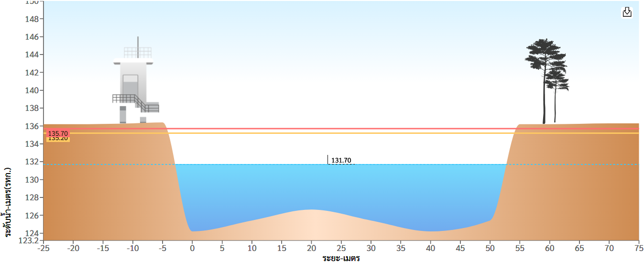
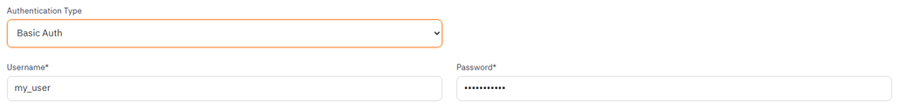
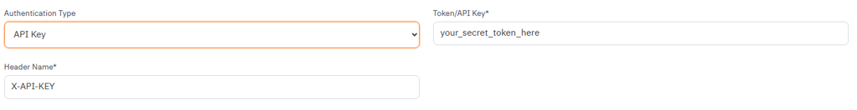
 |  | Home | CCTV | Statistics | Report | Event Log |  | Dashboard | User Settings | Log Out
7
📁Project
📁River Basin
📁Station
📁Sensor | >
📁Services | >
📁Team
📁User
<
Station - Edit
station_id
Status
Project
River Basin
▼
▼
โครงการส่งน้ำ
ชายฝั่งทะเลตะวันออก (จันทบุรี)
ชายฝั่งทะเลตะวันออก (ตราด)
โขงตะวันออกเฉียงเหนือ
ชายฝั่งทะเลตะวันออก
สาละวิน
โขงตะวันออกเฉียงเหนือ
Measured Value
Site Install (Optional)
▼
▼
ระดับน้ำ
ปริมาณน้ำฝน
ระดับน้ำ และปริมาณน้ำฝน
เขื่อน
อ่างเก็บน้ำ
ปตร.
ฝาย
สะพาน
DeviceID
Region
Site Code
Picture
Site Name
Delete
Address
Choose File
Latitude
Longitude
Zoom
Remark
station Setting
ข้อมูลท้องน้ำจุดที่ 1 ( Water Level Point 1)
ข้อมูลท้องน้ำจุดที่ 2 ( Water Level Point 2)
LEFT_BANK_WL_UP – ระดับตลิ่งซ้าย
LEFT_BANK_WL_DOWN – ระดับตลิ่งซ้าย
RIGHT_BANK_WL_UP – ระดับตลิ่งขวา
RIGHT_BANK_WL_DOWN – ระดับตลิ่งขวา
SamplingID
100▼
ZEROGATE_UP - ศูนย์เสาระดับ
ZEROGATE_DOWN - ศูนย์เสาระดับ
AreaID
100▼
GROUND_LEVEL_UP -ระดับท้องน้ำ
GROUND_LEVEL_DOWN -ระดับท้องน้ำ
BoxID
100▼
WARNING_UP – ระดับน้ำเตือนภัย
WARNING_DOWN – ระดับน้ำเตือนภัย
CRITICAL_UP – ระดับน้ำวิกฤต
CRITICAL_DOWN – ระดับน้ำวิกฤต
Water Setting
Sensor – เซ็นเซอร์ (Mapping SQL DataSensor TO DataStation)
Water Level Point 1 (UP)
Water Level Point 2 (DOWN)
MSL
MSL
101▼
SL
100▼
SL
Velocity - ความเร็วกระแสน้ำ
Flow Rate - อัตราการไหล
101▼
101▼
Direction - ทิศทางการไหล
Water Color - สีของน้ำ
100▼
100▼
ระดับน้ำฝน (Rainfall Level)
Garbage - พื้นที่ตะกอน %
100▼
100▼
REST API Server
Protocol
HTTP Port (Listener Port)
HTTP Source
Authentication
▼
0 – 65,535▼
▼
▼
HTTP
HTTPS
Both (HTTP & HTTPS)
Custom
Anywhere IPv4 ( 0.0.0.0 / 0 )
Anywhere IPv6 ( :: / 0 )
None
Basic Auth
Bearer Token
API Key
Generate Token
[ Generate ]
HTTPS Port (Listener Port)
HTTPS Source
SSL/TLS Mode
0 – 65,535▼
▼
▼
Custom
Anywhere IPv4 ( 0.0.0.0 / 0 )
Anywhere IPv6 ( :: / 0 )
OFF
One-Way SSL (Standard HTTPS – Server Authenticated)
Two-Way SSL (Mutual TLS / mTLS – Highly Secure)
{
"ADC_AI0_RAW": "0",
"ADC_AI0_V": "0.002",
"AccRF_DAY": "2.00",
"AccRF_DAY_LAST": "2.00",
"Area_Dec": "70.777",
"CustomTime": "1830",
"DI0": {
"last_changed": "2025-10-21T18:20:21.192884",
"state": 1
},
"DI2": {
"state": 4
},
"DIST": null,
"DO0": {
"state": 0
},
"DO1": {
"state": 0
},
"DO2": {
"state": 0
},
"DO3": {
"state": 0
},
"DayMonth": "2110",
"Flow_Dec": "-5.30",
"Humidity": "56.600",
"Humidity_LAST": "56.500",
"LatchTime": "1830",
"Level_ForPhoenix": null,
"MAX": "6.750",
"Phoenix_Area": null,
"Phoenix_Flowrate": null,
"Phoenix_Velocity": null,
"Power_Dec": "12.852",
"RAIN15": "2.00",
"RAIN_15M_LAST": "0.00",
"SDI12_Value_1": null,
"Temp_Dec": "2.43",
"Temperature": "24.30",
"Temperature2": "56.6",
"VOLT": "0.000",
"VOLT01": "0.000",
"Velocity_Dec": "-0.80",
"WL_4-20mA": "-3.732",
"WL_4-20mA_LAST": "-3.73",
"WL_Dec": "105.49",
"WL_Raw": null,
"WaterLevel_MSL": null,
"Year": "2025",
"last_updated": "2025-10-21T18:30:07.592149",
"system_time": "2025-10-21T18:30:07.592149"
}
SSL Certification File ( .crt / .pem )
SSL Private Key File ( .key )
[ Browse ]
[ Browse ]
CA Client Root Certificate
[ Browse ]
( *Required only for Two-Way mTLS Mode )
Inbound Data Mapping
( Fetch the custom mapping rules (JSONB dictionary) stored for that specific station to database )
# | Device JSON Key | Database Column | +
1 | RAIN_15M_LAST | RAIN | ➖
2 | VOLT | POWER | ➖
3 | DayMonth | Date | ➖
Upload image FTP
Server IP Address
Connection Mode
File Large Transfer
▼
▼
Port
Active Mode
Passive Mode
sm
lg
Timeout
Username
Transfer Type
TLS
▼
▼
Password
binary
ascii
NoTLSSupport
UseExplicitTLS
UseImplicitTLS
UseRequireTLS
Directory stricture
▼
Save in the root directory
Save in Parent Directory
Save in the child directory
Parent Directory
the child directory
Save
Cancel
Delete
Notes:
Triangle means dropdown (control select).

Slide 8
 |  | Home | CCTV | Statistics | Report | Event Log |  | Dashboard | User Settings | Log Out
7
📁 Project
📁 River Basin
📁Station
📁Sensor | v
Sensor
Camera
Sampling
📁Services | >
📁Team
📁User
<
Sensor (200)
▼
Status
Add
# | SensorID | Sensor Name | Sensen Type | Status | Remark | Action
1 | 1 | CCTV | Water Level | Active |  | Edit
2 | 2 | CCTV PTZ | Water Level | Active |  | Edit
3 | 50 | Formula | FLOW | Active |  | Edit
4 | 120 | Formula | FLOW | Active |  | Edit
5 | 145 | IR | Direction | Active |  | Edit
6 | 200 | Rain Only | Rain Level | Active |  | Edit
7 | 66 | CCTV | Velocity | Deactivated |  | Edit
8 |  |  |  |  |  | Edit

Slide 9
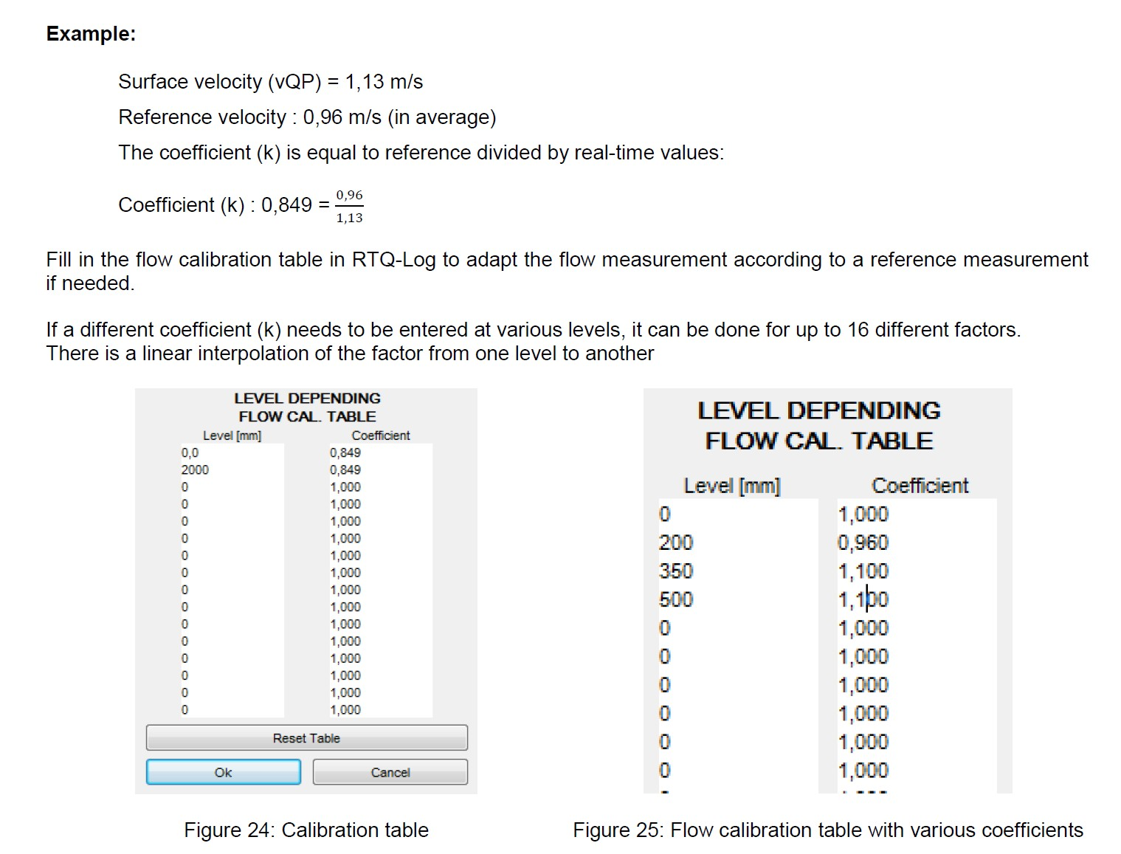
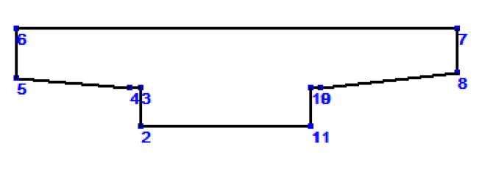
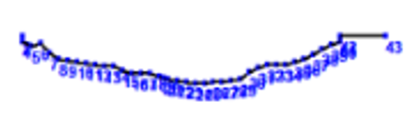
 |  | Home | CCTV | Statistics | Report | Event Log |  | Dashboard | User Settings | Log Out
7
📁 Project
📁 River Basin
📁Station
📁Sensor | v
Sensor
Camera
Sampling
📁Services | >
📁Team
📁User
<
Sensor - Add
SensorID
Status
Water Level
# | Sampling | CameraID |  | SamplingID |  | +
1 | 0 | 100 | ▼ | 10 | ▼ | ➖
2 | 1 | 50 | ▼ | 11 | ▼ | ➖
3 | 2 | 12 | ▼ | 12 | ▼ | ➖
Velocity
LEVEL DEPENDING VELOCITY CAL TABLE offset
# | Point 1 x | Point 1 y | Point 2 x | Point 2 y | +
1 | 0 | 200 | 900 | 400 | -
2 | 50 | 50 | 300 | 500 | -
3 | 600 | 200 | 700 | 300 | -
4 |  |  |  |  | -
5 |  |  |  |  | -
# | Coefficient (k) | Level | +
1 | 1.100 | 0.50 | -
2 | 1.100 | 0.35 | -
3 | 0.849 | 0.20 | -
4 | 0.950 | 0.10 | -
Flow
Ref.
Custom Profile
Profile
▼
ID | x-axis | y-axis | +
1 | 0 | 0 | -
2 | -2.600 | 0 | -
3 | -2.600 | 0.600 | -
4 | -2.750 | 0.600 | -
5 | -4.500 | 0.750 | -
6 | -4.500 | 1.500 | -
7 | 2.250 | 1.500 | -
8 | 2.250 | 0.830 | -
9 | 0.150 | 0.600 | -
10 | 0 | 0.600 | -
11 | 0 | 0 | -
Level [m] | Area [m²]
0.000 | 0.0000
0.600 | 1.5600
0.606 | 1.5778
0.612 | 1.5963
0.620 | 1.6222
0.624 | 1.6356
0.628 | 1.6494
0.636 | 1.6779
0.644 | 1.7078
0.648 | 1.7232
0.656 | 1.7551
0.660 | 17715
0.665 | 1.7925
0.670 | 1.8140
0.675 | 1.8361
0.680 | 1.8587
0.695 | 1.9053
0.695 | 1.9295
0.705 | 1.9793
0.710 | 2.0050
0.716 | 2.0365
0.722 | 2.0687
0.728 | 2.1017
0.734 | 2.1355
0.740 | 2.1700
0.746 | 2.2052
0.758 | 2.2776
0.772 | 2.3637
0.786 | 2.4516
0.801 | 2.5478
0.816 | 2.6460
1.500 | 7.2621
Level
Depth
วันที่ทำการสำรวจ (Survey Date)
📅
Remark
Direction
Move
▼
Right – Left
Left - Right
Forward – Backward
Backward - Forward
Garbage
Color
# | Point 1 x | Point 1 y | Point 2 x | Point 2 y | +
1 | 0 | 200 | 900 | 400 | -
2 | 50 | 50 | 300 | 500 | -
3 | 600 | 200 | 700 | 300 | -
4 |  |  |  |  | -
5 |  |  |  |  | -
Rain Level
# | Point 1 x | Point 1 y | Point 2 x | Point 2 y | +
1 | 0 | 200 | 900 | 400 | -
2 | 50 | 50 | 300 | 500 | -
3 | 600 | 200 | 700 | 300 | -
4 |  |  |  |  | -
5 |  |  |  |  | -
บันทึก
ยกเลิก
Deleteแ
Notes:
Velocity = average

Slide 10
 |  | Home | CCTV | Statistics | Report | Event Log |  | Dashboard | User Settings | Log Out
7
📁 Project
📁 River Basin
📁Station
📁Sensor | v
Sensor
Camera
Sampling
📁Services | >
📁Team
📁User
<
Camera (300)
▼
Status
Add
# | CameraID | Camera Name | Status | Remark | Action
1 | 1 | โครงการส่งน้ำ | Active |  | Edit
2 | 2 | มหาสารคาม | Active |  | Edit
3 | 50 | สำนัก 6 | Active |  | Edit
4 | 120 | การไฟฟ้า | Active |  | Edit
5 | 145 | การประปา | Active |  | Edit
6 | 200 | ทดสอบ | Active |  | Edit
7 | 66 | ลำปลายมาศ | Deactivated |  | Edit
8 |  |  |  |  | Edit

Slide 11
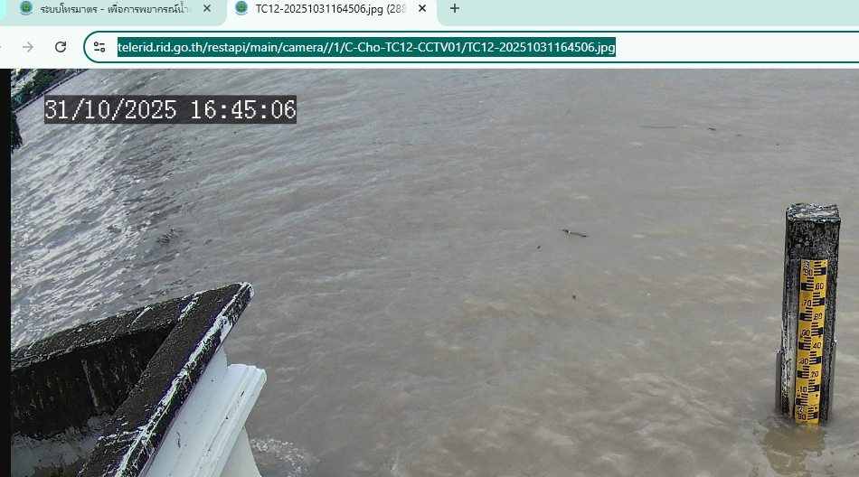
 |  | Home | CCTV | Statistics | Report | Event Log |  | Dashboard | User Settings | Log Out
7
📁 Project
📁 River Basin
📁Station
📁Sensor | v
Sensor
Camera
Sampling
📁Services | >
📁Team
📁User
<
Camera - Add
CameraID
Status
Camera Name
StationID
Camera_Type
CCTV_NO
▼
▼
▼
-- Choose --
TC.04 – สะพานพุทธ (DeviceID)
TC.12 – กรมชลประทาน (DeviceID)
-- Choose --
Sensor
Overview
Security
-- Choose --
1
2
3
Camera_Source
▼
-- Choose --
FTP
RTSP ( Real-Time Streaming Protocol )
RSTP_IP
Port
Username
Password
Profile (Model Trained)
Channels ID
FPS
▼
5 MP ( 2592 × 1944 )
4 MP ( 2560 x 1440 )
4 MP ( 2688 x 1520 )
2 MP ( 1920 x 1080 )
1 MP ( 1280 x 720 )
rtsp://<username>:<password>@<IP_address>:<port>/Streaming/Channels/<ID>
Onvif (ONVIF Profile G Specification )
Onvif_IP
Port
Username
Password
Upload JPG ( To Another server)
Server IP Address
Connection Mode
File Large Transfer
▼
▼
Port
Active Mode
Passive Mode
sm
lg
Timeout
Username
Transfer Type
TLS
▼
▼
Password
binary
ascii
NoTLSSupport
UseExplicitTLS
UseImplicitTLS
UseRequireTLS
Directory stricture
▼
Save in the root directory
Save in Parent Directory
Save in the child directory
Parent Directory
the child directory
บันทึก
ยกเลิก
Deleteแ

Slide 12
 |  | Home | CCTV | Statistics | Report | Event Log |  | Dashboard | User Settings | Log Out
7
📁 Project
📁 River Basin
📁Station
📁Sensor | v
Sensor
Camera
Sampling
📁Services | >
📁Team
📁User
<
SamplingID (55)
▼
Status
Add
# | SamplingID | Sampling Name | Status | Action
1 | 1 |  | Active | Edit
2 | 2 |  | Active | Edit
3 | 50 |  | Active | Edit
4 | 120 |  | Active | Edit
5 | 145 |  | Active | Edit
6 | 200 |  | Active | Edit
7 |  |  | Deactivated | Edit
8 |  |  |  | Edit

Slide 13
 |  | Home | CCTV | Statistics | Report | Event Log |  | Dashboard | User Settings | Log Out
7
📁 Project
📁 River Basin
📁Station
📁Sensor | v
Sensor
Camera
Sampling
📁Services | >
📁Team
📁User
<
SamplingID - Add
SamplingID
Status
# | x-axis | y-axis
1 | 31 | 3 | ➖
2 | 60 | 2.9 | ➖
3 | 88 | 2.8 | ➖
4 | 117 | 2.7 | ➖
5 | 145 | 2.6 | ➖
6 | 174 | 2.5 | ➖
7 | 202 | 2.4 | ➖
8 | 232 | 2.3 | ➖
* |  |  | ➕
วันที่สร้าง (Creation Date)
📅
Sampling Name
บันทึก
ยกเลิก

Slide 14
 |  | Home | CCTV | Statistics | Report | Event Log |  | Dashboard | User Settings | Log Out
7
📁 Project
📁 River Basin
📁Station
📁Sensor | >
📁Services | v
File Transfer
HTTP
CSV Logger
📁Team
📁User
<
File Transfer (15)
▼
Status
เพิ่ม
# | FileTransferID | Site | Hostname | Remark | การกระทำ
1 | 1 | โครงการส่งน้ำ | 111.111.111.111 |  | Edit
2 | 2 | มหาสารคาม | 111.111.111.112 |  | Edit
3 | 5 | สำนัก 6 | 111.111.111.113 |  | Edit
4 | 6 | การไฟฟ้า | 111.111.111.114 |  | Edit
5 | 3 | การประปา | 111.111.111.115 |  | Edit
6 | 4 | ทดสอบ | 111.111.111.116 |  | Edit
7 | 8 | ลำปลายมาศ | 111.111.111.117 |  | Edit
8 |  |  |  |  | Edit

Slide 15
 |  | Home | CCTV | Statistics | Report | Event Log |  | Dashboard | User Settings | Log Out
7
📁 Project
📁 River Basin
📁Station
📁Sensor | >
📁Services | v
File Transfer
HTTP
CSV Logger
📁Team
📁User
<
File Transfer - Edit
File transfer_id
Hostname
Passive
File Large Transfer
▼
▼
Port
Active Mode
Passive Mode
sm
lg
Timeout
Username
Transfer Type
TLS
▼
▼
Password
binary
ascii
NoTLSSupport
UseExplicitTLS
UseImplicitTLS
UseRequireTLS
Remark
Directory stricture
▼
Parent Directory
/
Save in the root directory
Save in Parent Directory
Save in the child directory
the child directory
/___ /___
บันทึก
ยกเลิก
Deleteแ

Slide 16
 |  | Home | CCTV | Statistics | Report | Event Log |  | Dashboard | User Settings | Log Out
7
📁 Project
📁 River Basin
📁Station
📁Sensor | >
📁Services | v
File Transfer
HTTP
CSV Logger
📁Team
📁User
<
HTTP (15)
▼
http logs
Status
เพิ่ม
# | HTTPID | Site | Hostname | Status | การกระทำ
1 | 1 | โครงการส่งน้ำ | 111.111.111.111 |  | Edit
2 | 2 | มหาสารคาม | 111.111.111.112 |  | Edit
3 | 5 | สำนัก 6 | 111.111.111.113 |  | Edit
4 | 6 | การไฟฟ้า | 111.111.111.114 |  | Edit
5 | 3 | การประปา | 111.111.111.115 |  | Edit
6 | 4 | ทดสอบ webhook.site | https://webhook.site/c6dbf320-6e4d-422a-9cf1-084ae3268815 |  | Edit
7 | 8 | ลำปลายมาศ | 111.111.111.117 |  | Edit
8 |  |  |  |  | Edit

Slide 17

 |  | Home | CCTV | Statistics | Report | Event Log |  | Dashboard | User Settings | Log Out
7
📁 Project
📁 River Basin
📁Station
📁Sensor | >
📁Services | v
File Transfer
HTTP
CSV Logger
📁Team
📁User
<
HTTP - Edit
HTTPID
Status
device_id
▼
Server URL (Host URL)
Context Type*
TC.12
TC.04
HTTP Method*
JSON
Plain Text
POST
GET
PUT
Timeout (seconds)*
Authentication
None
Basic Auth
Bearer Token
API Key
Parameter Mapping
# | SOURCE TYPE | PARAMETER NAME (FOR API) | SOURCE VALUE / DISPLAY NAME | +
 | Static Value v | HYDRO | 1 | -
 | Static Value v | SITE | P.73 | -
 | Static Value v | BASIN | 5 | -
 | Sensor Data v | WL | WL_4-20mA | -
 | Sensor Data v | RF | RAIN15 | -
 | Datetime v | DT | yyyymmddHHMM | -
ตัวอย่าง {"HYDRO": "1", "SITE": "P.73", "BASIN": "5", "WL": "-5.305", "RF": "0.00", "DT": "202604212000"}
Advanced Settings
Retry Attempts
Retry Delay (Seconds)
Verify SSL Certificate
2
10
บันทึก
ยกเลิก
Delete

Slide 18
 |  | Home | CCTV | Statistics | Report | Event Log |  | Dashboard | User Settings | Log Out
7
📁 Project
📁 River Basin
📁Station
📁Sensor | >
📁Services | v
File Transfer
HTTP
CSV Logger
📁Team
📁User
<
http logs (15)
วันที่ – ถึงวันที่ (Creation Date)
▼
▼
📅
River Basin
Project
▼
Status
Queue
Sent (Success)
Failed
Queue ทั้งหมด
Sent ทั้งหมด
Failed ทั้งหมด
# | id | device_id | content | Status
1 | 1 | โครงการส่งน้ำ | {"HYDRO": "1", "SITE": "P.73", "BASIN": "5", "WL": "-5.305", "RF": "0.00", "DT": "202604212000"}
2 | 2 | มหาสารคาม | {"HYDRO": "1", "SITE": "P.73", "BASIN": "5", "WL": "-5.305", "RF": "0.00", "DT": "202604212000"}
3 | 5 | สำนัก 6 | {"HYDRO": "1", "SITE": "P.73", "BASIN": "5", "WL": "-5.305", "RF": "0.00", "DT": "202604212000"}
4 | 6 | การไฟฟ้า | {"HYDRO": "1", "SITE": "P.73", "BASIN": "5", "WL": "-5.305", "RF": "0.00", "DT": "202604212000"}
5 | 3 | การประปา | {"HYDRO": "1", "SITE": "P.73", "BASIN": "5", "WL": "-5.305", "RF": "0.00", "DT": "202604212000"}
6 | 4 | ทดสอบ webhook.site | {"HYDRO": "1", "SITE": "P.73", "BASIN": "5", "WL": "-5.305", "RF": "0.00", "DT": "202604212000"}
7 | 8 | ลำปลายมาศ | {"HYDRO": "1", "SITE": "P.73", "BASIN": "5", "WL": "-5.305", "RF": "0.00", "DT": "202604212000"}
8
▼
Status
บันทึก
ยกเลิก
Delete

Slide 19
 |  | Home | CCTV | Statistics | Report | Event Log |  | Dashboard | User Settings | Log Out
7
📁 Project
📁 River Basin
📁Station
📁Sensor | >
📁Services | v
File Transfer
HTTP
CSV Logger
📁Team
📁User
<
CSV Logger (2)
▼
Status
เพิ่ม
# | CSV logger_id | File Transfer_id | Filename Format | Status | การกระทำ
1 | 1 | 5 | @DEVICENAME_DataRecovery_%d%m%Y.csv |  | Edit
2 | 2 | 3 | @DEVICENAME_%d%m%y.csv |  | Edit

Slide 20
 |  | Home | CCTV | Statistics | Report | Event Log |  | Dashboard | User Settings | Log Out
7
📁 Project
📁 River Basin
📁Station
📁Sensor | >
📁Services | v
File Transfer
HTTP
CSV logger
📁Team
📁User
<
CSV logger - Edit
CSV logger_id
Status
file transfer_id
▼
Log Interval (minutes):
Filename Format:
15
@DEVICENAME_DataRecovery_%d%m%Y.csv
Time taken to save data to a CSV file (minutes)
Example : TC.04_DataRecovery_12052026.csv
Place Device Name on the first line of CSV Header
Parameter Mapping
Drag and drop to rearrange column order.
# | HEADER NAME (FILE_HEADER) | SOURCE VARIABLE(FILE_FORMAT) | ➕
 | DEVICE | %DEVICENAME% | ➖
 | Date | %DATE_DMY% | ➖
 | Time | %TIME% | ➖
 | WL | %WL% | ➖
 | Q | %Q% | ➖
 | V | %V% | ➖
 | A | %VAR_10% | ➖
 | POWER | %VAR_11% | ➖
 | TEMP | %VAR_20% | ➖
 | HUM | %VAR_21% | ➖
 | RAIN15 | %VAR_8% | ➖
F
# | Project Name
□ | 1 โครงการมูน | v
□ | 1.1 TMB.01
□ | 2 โครงการเจ้าพระยา | >
□ | 3 | >
□ | 4 | >
# | River Basin Name
□ | 1 ลุ่มน้ำเจ้าพระยา | v
□ | 1.1 TC.12 - สามเสน
□ | 2 ลุ่มมน้ำมูลบน | >
□ | 2.1 TC.04 - สะพานพุทธ
□ | 2.2 TMB.01
□ | 3 | >
□ | 4 | >
□ | 5 | >
□ | 6 | >
Reference Guide
Filename Format Placeholders
Use to name CSV file
@DEVICENAME : Device name
@DATE : Date (YYYY-MM-DD format)
You can also use Date/Time Format Codes as below.
CSV Column Format Placeholders
%DEVICENAME% : Device Name
%DATETIME% : Full date and time (YYYY-MM0DD HH:MM:SS)
%DATE_DMY% : Date (DD/MM/YY)
%VAR**% : The value of the variable from the declare page.
Date/Time Format Codes (For Filenames)
Code | Example | Description
%Y | 2025 | Year Four digit
%y | 25 | Year Two digit
%m | 08 | Month (01-12)
%d | 12 | Date (01-31)
%H | 06 | Hours (00-23)
%M | 22 | Minutes (00-59)
%S | 26 | Seconds (00-59)
Show only
บันทึก
ยกเลิก
Deleteแ

Slide 21
 |  | Home | CCTV | Statistics | Report | Event Log |  | Dashboard | User Settings | Log Out
7
📁 Project
📁 River Basin
📁Station
📁Sensor | >
📁Services | >
📁Team
📁User
<
Team (15)
▼
Status
เพิ่ม
# | team_id | Team Name | Remark | การกระทำ
1 | 1 | Administrator |  | Edit
2 | 2 | RID - ภาคเหนือ |  | Edit
3 | 5 | Praewpan |  | Edit
4 | 6 | การไฟฟ้า |  | Edit
5 | 3 | network |  | Edit
6 | 4 | test |  | Edit
7 | 8 | RID |  | Edit
8 |  |  |  | Edit

Slide 22
 |  | Home | CCTV | Statistics | Report | Event Log |  | Dashboard | User Settings | Log Out
7
📁 Project
📁 River Basin
📁Station
📁Sensor | >
📁Services | >
📁Team
📁User
<
Team - Edit
team_id
team_name
# | Project Name
□ | 1 โครงการมูน | v
□ | 1.1 TMB.01
□ | 2 โครงการเจ้าพระยา | >
□ | 3 | >
□ | 4 | >
# | Username | Firstname | E-mail
□ | RID - ภาคเหนือ |  | abcd@gmail.com
□ | Praewpan |  | abcd@gmail.com
□ | การไฟฟ้า |  | abcd@gmail.com
□ | network |  | abcd@gmail.com
□ | test |  | abcd@gmail.com
□ | RID |  | abcd@gmail.com
□ | RID 2 |  | abcd@gmail.com
□
# | River Basin Name
□ | 1 ลุ่มน้ำเจ้าพระยา | v
□ | 1.1 TC.12
□ | 2 ลุ่มมน้ำสาละวิน | >
□ | 3 | >
□ | 4 | >
บันทึก
ยกเลิก
Deleteแ

Slide 23
 |  | Home | CCTV | Statistics | Report | Event Log |  | Dashboard | User Settings | Log Out
7
📁 Project
📁 River Basin
📁Station
📁Sensor | >
📁Services | >
📁Team
📁User
<
User (15)
▼
Status
เพิ่ม
# | UserID | Username | User Type | Status | Remark | การกระทำ
1 | 1 | Administrator | Admin | Active |  | Edit
2 | 2 | RID - ภาคเหนือ | Supervisor | Active |  | Edit
3 | 5 | Praewpan | Supervisor | Active |  | Edit
4 | 6 | การไฟฟ้า | Staff | Active |  | Edit
5 | 3 | network | Staff | Active |  | Edit
6 | 4 | test | guest | Active |  | Edit
7 | 8 | RID | guest | Deactivated |  | Edit
8 |  |  |  |  |  | Edit

Slide 24
 |  | Home | CCTV | Statistics | Report | Event Log |  | Dashboard | User Settings | Log Out
7
📁 Project
📁 River Basin
📁Station
📁Sensor | >
📁Services | >
📁Team
📁User
<
User - Edit
UserID
Status
Username
Firstname
Lastname
E-mail
User Permission
▼
Admin
Supervisor
Staff
Guest
Password
Password Confirm
Remark
บันทึก
ยกเลิก
Delete
User Type | Permission
Admin | All
Supervisor | Except Dashboard
Staff | Except Dashaboard, Event_Log
Guest | Only Home Page with Only filter River, Show Only normal station

